Slide 1

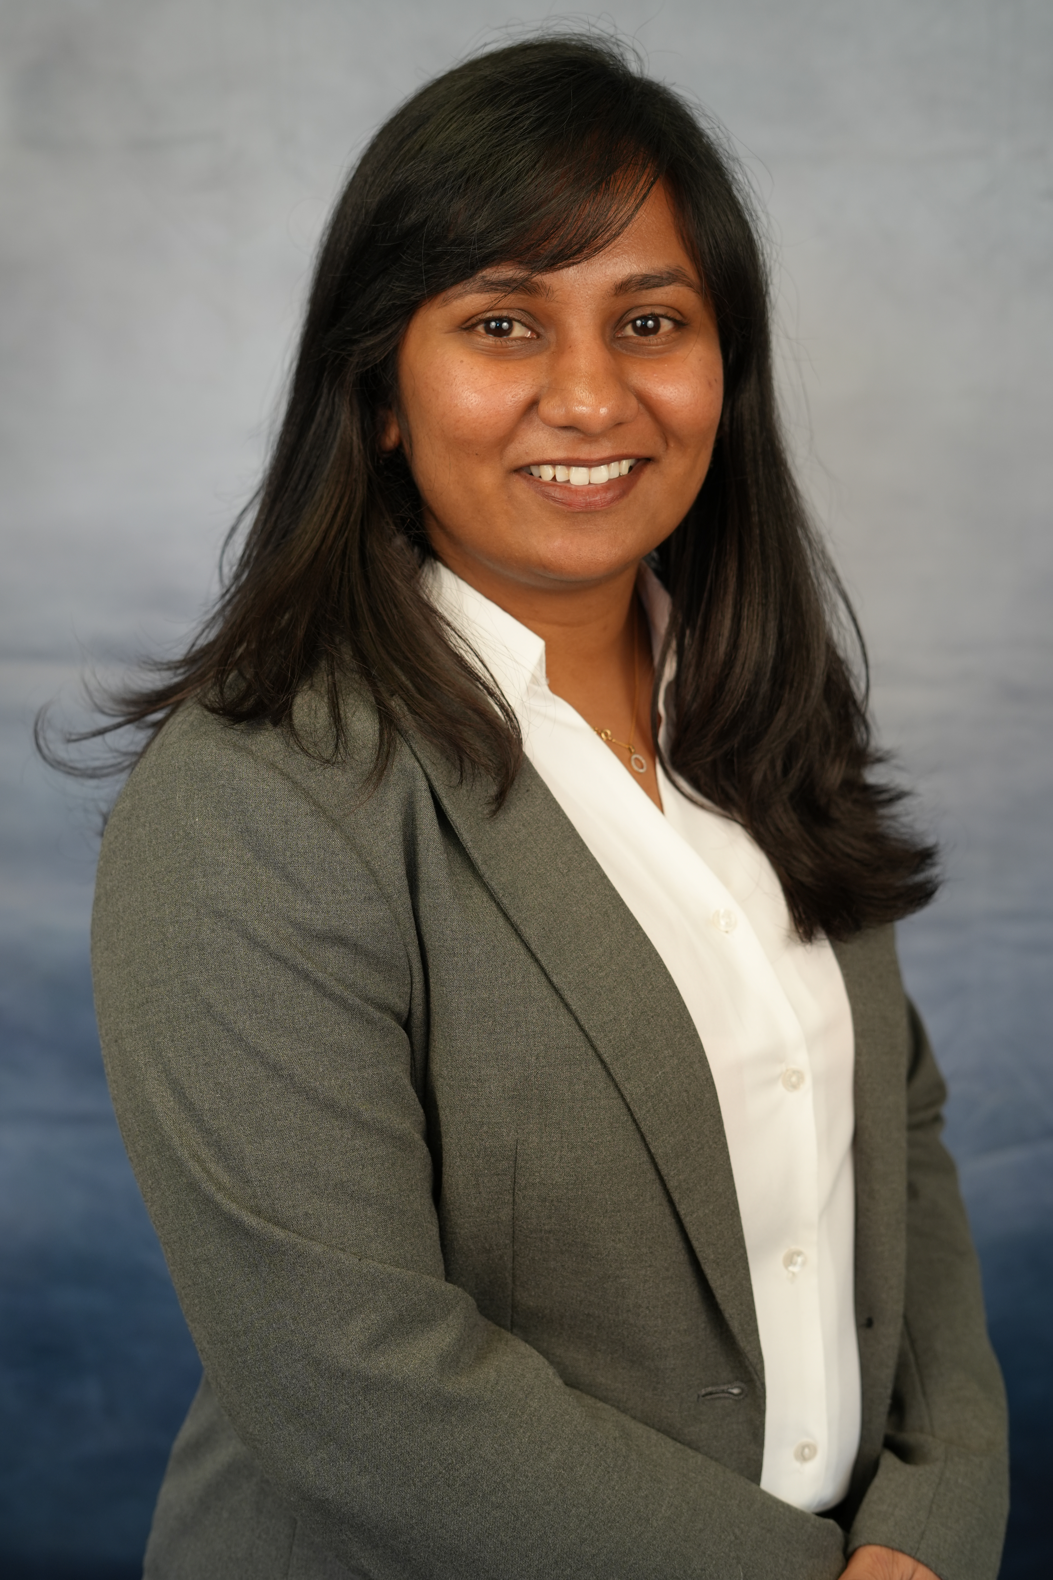
Image Caption Generation using CNN and LSTM DATA612-DEEP learning Summer24 Date: 05 Aug 2024
By Swathi Baskaran
UID: 120428326

Slide 2
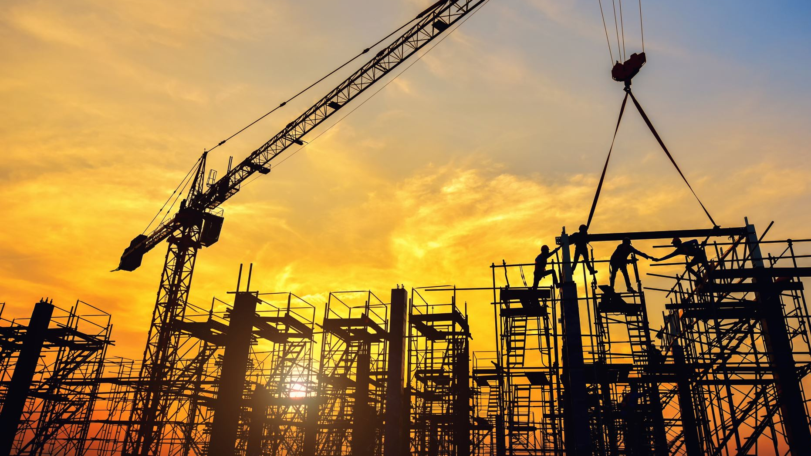

Table of Contents
Introduction
Objectives
Dataset Description
Methodology
Data Preprocessing
CNN for Feature Extraction
LSTM for Sequence Prediction
Attention Mechanism
Model Architecture
Training the Model
Results
Analysis and Discussion
Challenges and Solution
Conclusion and Future Work

Slide 3

Introduction
Limitations of traditional methods:
Difficulty in handling diverse images and complex scenes
Lack of generalization to unseen objects and situations
Advantages of deep learning: Ability to learn complex patterns from large datasets.
Hierarchical Feature Learning
Wide range of applications:
Accessibility: helping visually impaired users understand image content
Content management: automating tagging and categorization of large image databases
Search engines: improving image search accuracy and relevance
Social media: enhancing content description and engagement
Robotics: improving machine understanding of environments
Scalability and Adaptability

Slide 4
Objectives
Main Goal: To generate accurate and descriptive caption for images
Key aspects:
Understanding visual content (objects, actions, relationships).
Translating visual understanding into natural language.
Generating grammatically correct and contextually relevant sentences.
Specific Objectives
- Use of CNN for feature extraction
- Use of LSTM for sequence generation
- Incorporation of the attention mechanism

Slide 5
Dataset Selection
Initial Choice: Flickr30k
31,000 images
Dataset: Flickr8k
8,ooo images collected
Characteristics:
Diverse range of everyday scenes, activities, and objects
Advantages:
Well-established benchmark in the field
Allows for direct comparison with other models
Large enough for deep learning, yet manageable for experimentation
Captures different human perspectives on image description
Computationally
Expensive
Longer Runtime
5 independent and descriptive, human-generated captions per image

Slide 6
Methodology
Data Preprocessing: Image and Text Preprocessing
Incorporation of attention mechanism
Training the model and Evaluation
Use of CNN for feature extraction:
Pre-trained Model – DenseNet201
Use of LSTM for sequence generation

Slide 7
Data Preprocessing
Image Preprocessing
1
Resizing
Normalization
Text Preprocessing
2
Tokenization
Vocabulary Creation
Padding Sequence
Splitting dataset into training and validation sets
3

Slide 8
CNN for Feature Extraction
Model Used:
Initial choice: VGG16 or ResNet
Pre-trained Model: DenseNet201
Why DenseNet201?
Efficient Feature Propagation
Fewer Parameters
High Accuracy
How CNN is used to extract features from Images
Important features
Edges and Textures
Shapes and Objects
Contextual Information

Slide 9
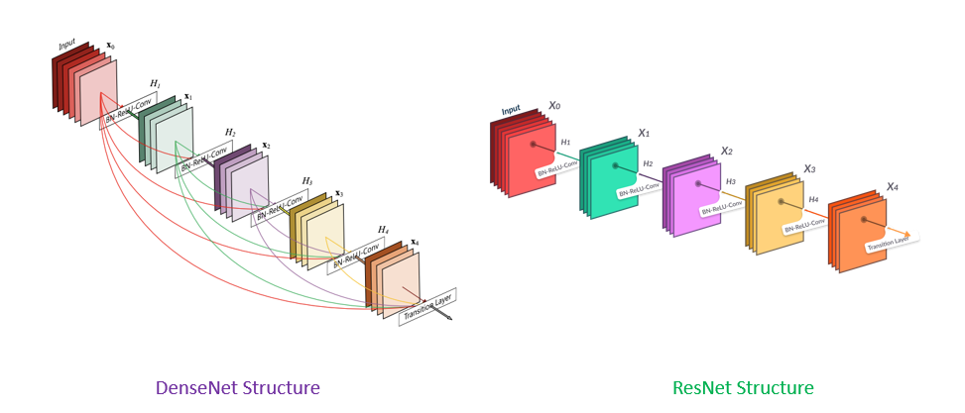

Slide 10
LSTM for Sequence Prediction
LSTM and its role in generating captions
Recurrent Neural Network (RNN)
Memory Cells and Gates
How LSTM works for Sequence Prediction
Input Processing
Maintaining Context
Generating output
Sequential Prediction
Advantages
Handling Long Term Dependencies
Flexibility in Sequence Lengths
Improved Accuracy
LSTM processes the extracted features and generates sequences

Slide 11
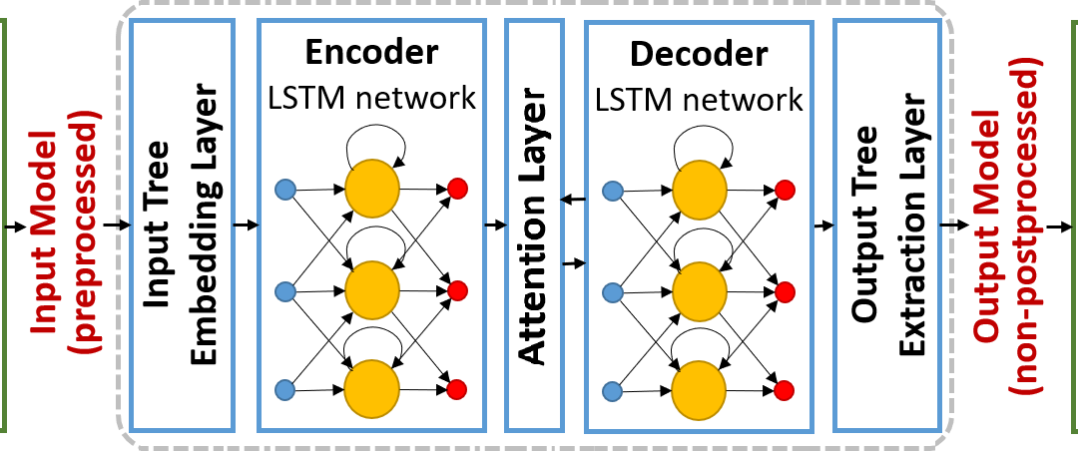
LSTM and Attention Mechanism Architecture

Slide 12
Attention Mechanism
Purpose: The attention mechanism helps the model focus on relevant parts of the input sequence when generating each part of the output sequence.
Imagine you are reading a sentence and trying to translate it to another language. When you focus on translating a particular word, you tend to pay more attention to certain words in the original sentence that provide context for that translation. Similarly, the attention mechanism assigns higher weights to the more relevant words.
How is it implemented
Encoding Input
Score Calculation
Softmax function
Context Vector
Output Generation

Slide 13
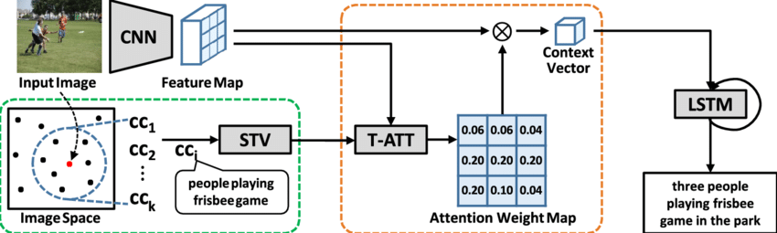
Model Architecture

Slide 14

Training the Model
DenseNet201 effectively extracts high-level features from images.
Categorical Cross-Entropy Loss: Measures the dissimilarity between the predicted word probabilities and the actual word labels.
Optimization with Adam: Efficiently updates model parameters to reduce the training loss.
Training Process and Parameters:
The training process involved several key parameters:
Batch size: 64
Learning rate: 0.001
Number of epochs: 20
Dataset split: We divided the dataset into training, testing and validation sets to monitor performance and prevent overfitting

Slide 15
Challenges and Solution
Overfitting
Description: Model performed well on training data but poorly on validation data.
Solution: Implemented regularization techniques like dropout and monitored validation loss for early stopping.
Generalization Across Diverse Images
Description: Difficulty in ensuring the model generalizes well to various image contexts.
Solution: Utilized the attention mechanism to allow the model to focus on relevant parts of the image for each word in the caption.
Computational Resource Limitations
Description: Initial dataset (Flickr30k) was too resource-intensive, making training impractical.
Solution: Switched to the more manageable Flickr8k dataset, balancing dataset size with computational feasibility.
Balancing Model Complexity and Performance
Description: Finding the right balance between a complex model that captures details and a simpler, more efficient model.
Solution: Experimented with different architectures and hyperparameters to find an optimal balance, leveraging pre-trained models for efficient feature extraction.

Slide 16
Results
EVALUATION METRICS
BLEU Score
Description: Bilingual Evaluation Understudy (BLEU) score measures the quality of generated text by comparing it with one or more reference texts.
Importance: BLEU scores are widely used in natural language processing tasks to evaluate the fluency and accuracy of generated sequences, such as machine translation and image captioning.
Training and Validation Loss
Description: The training and validation loss curves indicate how well the model is learning and generalizing.

Slide 17
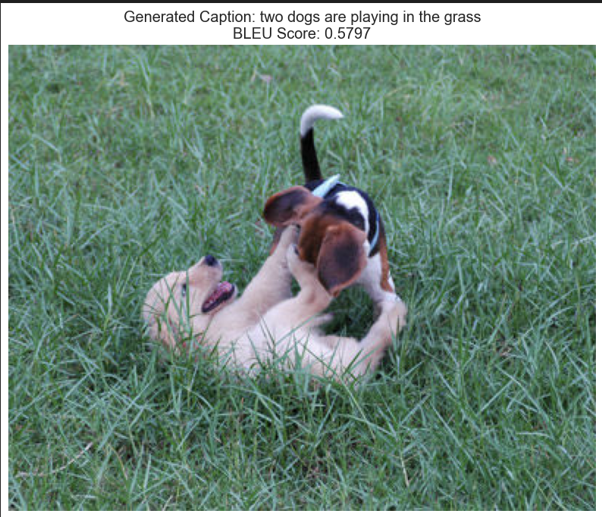
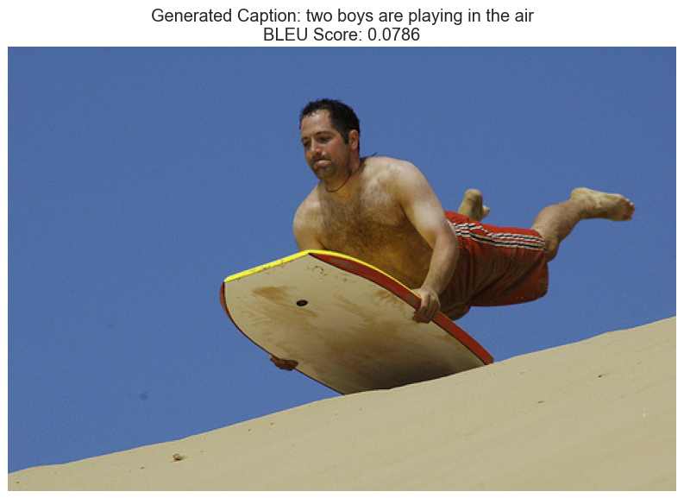
Generated Captions with BLEU score

Slide 18
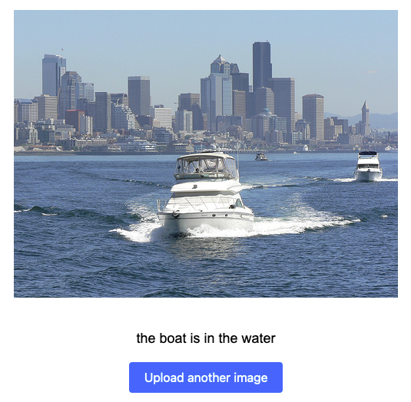
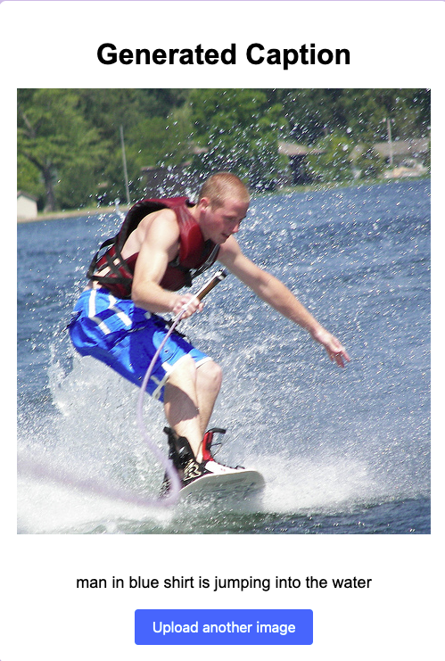
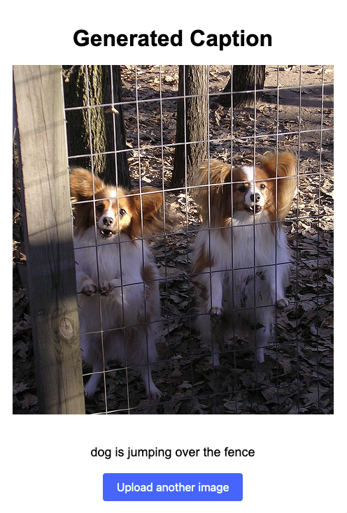
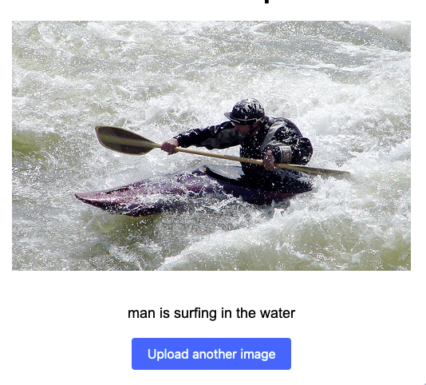

Slide 19
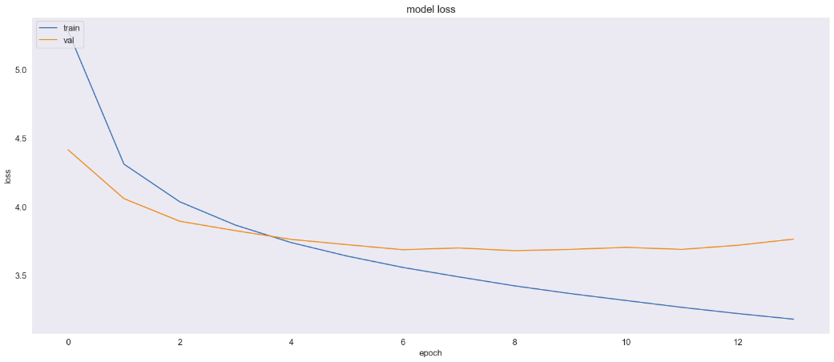
Training
and
Validation
Loss
Epoch vs Loss Graph:
X-axis (Epochs): Represents the number of epochs
Y-axis (Loss): Represents the loss value, which is a measure of the error between the predicted captions and the actual captions.
Observation: Training loss consistently decreases, while validation loss plateaus and then increases, indicating learning with some signs of overfitting.

Slide 20
Analysis and Discussions
Strengths:
Accurate Captions: In many cases, the model generated accurate and contextually relevant captions, demonstrating its ability to understand and describe image content effectively.
Context Understanding: The attention mechanism helped the model focus on relevant parts of the image, improving the relevance and detail of the captions.
Weaknesses:
Overfitting: The model showed signs of overfitting, it performed well on the training data but less effectively on the validation set.
Scene Misidentification: The model struggled with accurately identifying scenes and objects in some cases, leading to incorrect captions. Insufficient training data due to computational resource limitations.
Improvements:
To address the weaknesses, I explored regularization techniques and reduced the number of epochs to reduce overfitting, another option was to enhance the training dataset with more diverse images and refine the attention mechanism.
Employed the Adam optimizer, which adaptively adjusts the learning rate during training for optimal performance.

Slide 21
Potential Applications
Accessibility Tools: Generate audio descriptions of images for visually impaired individuals.
Image Search Engines: Enhance image search results by including relevant captions for improved retrieval.
Social Media Platforms: Automatically generate captions for user-uploaded images, saving time and effort.
Robotics and Automation: Enable robots to understand and describe their visual surroundings for improved navigation and interaction.

Slide 22
Conclusion and Future Work
Conclusion
This project successfully demonstrated the effectiveness of combining CNNs, LSTMs, and attention mechanisms for image caption generation.
Future Work
Explore large datasets like COCO, FLickr30k, etc
Incorporate more advanced architectures (e.g., Transformers)
Explore multi-modal learning techniques
Investigate domain-specific applications (e.g., Medical imaging)
Extend to video captioning or dense captioning tasks

Slide 23

Thank You Questions?

